Slide 1
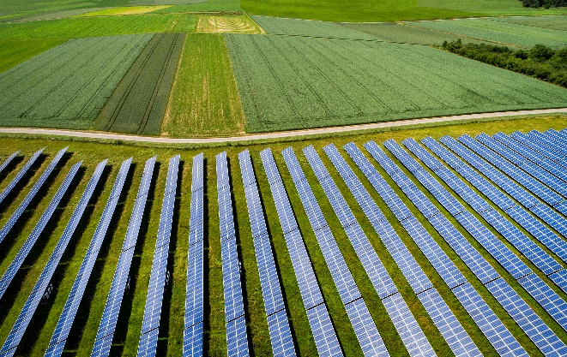
Data and Digitalisation Priorities 17th November 2022
19.09.2022

Slide 2
Introduction
Bryan O’Neill, Head of Energy System Data Architecture
“The digitalisation of the energy sector is critical to reaching net zero by 2050 and supporting a smart, flexible energy system.”
BEIS Smart System and Flexibility Plan 2021

Slide 3
Smart Flexible Energy System
A smart, flexible energy system reduces consumer energy bills by reducing the amount of generation and network assets that need to be built to meet peak demand.
It gives consumers greater control over their energy bills, through access to smart technologies and services. It facilitates the integration of local solutions for low carbon power, heat and transport.
Smart
Smart is the ability of a device to respond in real time to communication signals, using digital technologies, to deliver a service
Flexibility
Flexibility is the ability to shift in time or location the consumption or generation of energy
Smart & Flexible
A system of devices to balance supply and demand and manage constraints on the network

Slide 4
Digital Energy System Ambitions
Consumer Benefits
Advanced Pricing Signals
Innovation
Markets for Flexible Solutions
Smart Metering Systems
Open Data +Data Best Practice
Reliable Network Data
Advanced Network Planning and Ops
Reliable Asset Data
A future digital energy ecosystem, including suppliers, customers, networks, operators, new applications, third-party data service providers must
• Reduce risks through visibility, ensuring collection and publication of data about what is happening: LV visibility, markets, decentralised assets, etc.
• Increase participation through clear treatment of risks (leading to trust), while minimising negative or harmful practices for consumers
• Increase data exchange through standards, ensuring standards are coordinated, secure and easy to understand and apply
• Change the industry’s culture, to make sure digitalisation is valued and understood

Slide 5
The Story So Far
BEIS Net Zero Innovation Funding
Automatic Asset Registration
3 Innovation Projects funded by BEIS to consider options to enable and encourage automatic asset registration
Smart Meter Data Repository
A Project funded to consider technical options for enabling greater access to anonymised smart meter data
Digital Spine
The tender is a in place for scoping study to progress the Digital Spine concept and facilitate better data sharing across industry.
Policy and Regulation
Smart and secure electricity system Consultation
A Policy enabler for large scale, distributed flexibility. Standards, security and digitalisation all front and centre
Data Best Practice Call for Input
updates to Data Best Practice Guidance including potentially viewing aggregated smart meter data as system data
ED2 Draft Determinations
Proposes and funds a step change in digitalisation, and network visibility

